Slide 1
Ardent PPT
PPT ON JAVA
Prepared By Sumon Karmakar

Slide 2
PPT On Java
Java is a Programming Language and Platform independent.
is a high level, robust, secured and object-oriented programming language.
Platform: Any hardware or software environment in which a program runs, is known as a platform. Since Java has its own runtime environment (JRE) and API, it is called platform .
E.g:-
class Simple{
public static void main(String args[]){
System.out.println("Hello Java");
}
}
O/p:- Hello Java

Slide 3
PPT On Java
Use Of Java:-
Desktop Applications such as acrobat reader, media player, antivirus etc.
Web Applications such as irctc.co.in, javatpoint.com etc.
Enterprise Applications such as banking applications.
Mobile
Embedded System
Smart Card
Robotics
Games etc.

Slide 4
PPT On Java
Types of Java Application:-
Stand Alone Application
Web Application
Enterprise Application
Mobile Application

Slide 5
PPT On Java
Version of Java :-
JDK Alpha and Beta (1995)
JDK 1.0 (23rd Jan, 1996)
JDK 1.1 (19th Feb, 1997)
J2SE 1.2 (8th Dec, 1998)
J2SE 1.3 (8th May, 2000)
J2SE 1.4 (6th Feb, 2002)
J2SE 5.0 (30th Sep, 2004)
Java SE 6 (11th Dec, 2006)
Java SE 7 (28th July, 2011)
Java SE 8 (18th March, 2014)
Java SE 9 (21st September 2017)
Java SE 10(20th March 2018)

Slide 6
PPT On Java
Features of Java :-
Simple
Object-Oriented
Platform Independent
Secured
Robust
Architecture Neutral
Portable
Dynamic
Interpreted
High Performance
Multithreaded
Distributed

Slide 7
PPT On Java
Simple Program of Java :-
class Simple{
public static void main(String args[]){
System.out.println("Hello Java");
}
}
O/p:- Hello Java

Slide 8
PPT On Java
Path Set in Java:-
There are 2 ways to set java path:
temporary
Permanent

Slide 9
PPT On Java
Path Set in Java:-
Temporary
To set the temporary path of JDK, you need to follow following steps:
Open command prompt
copy the path of jdk/bin directory
write in command prompt: set path=copied_path
For Example:
set path=C:\Program Files\Java\jdk1.6.0_23\bin

Slide 10
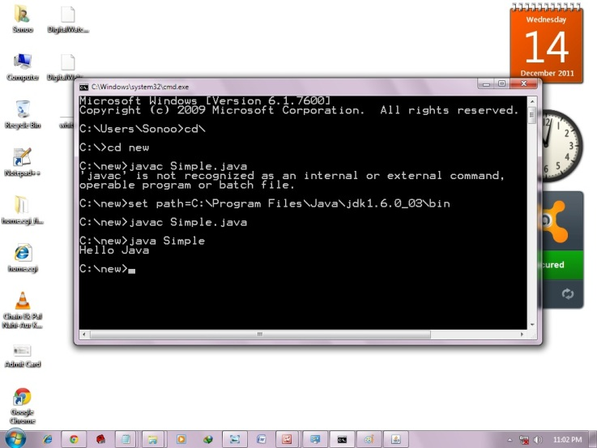
PPT On Java
Path Set in Java:-
Temporary

Slide 11
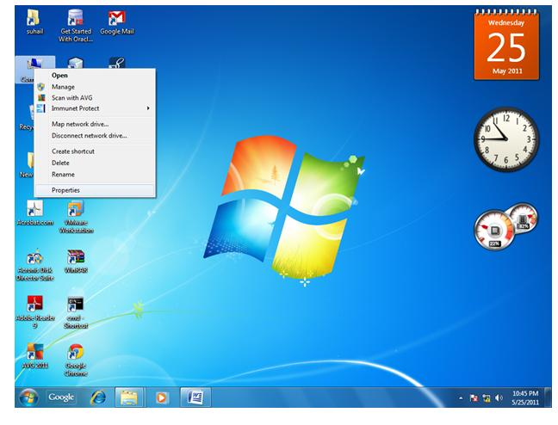
PPT On Java
Path Set in Java:-
Permanent:-
1.Go to My Computer properties :

Slide 12
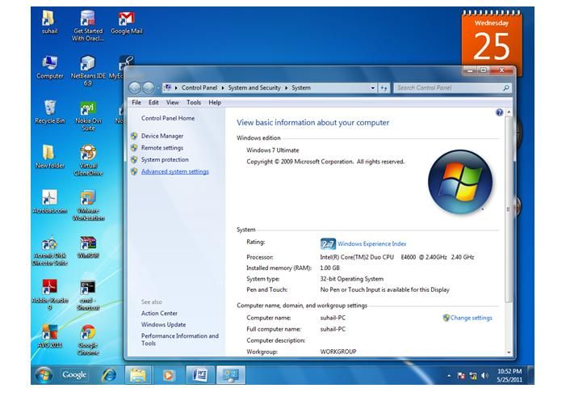
PPT On Java
Path Set in Java:-
Permanent:-
2.Click on advance tab:

Slide 13
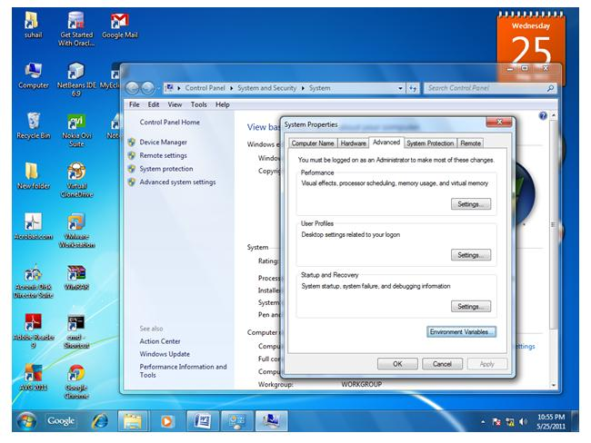
PPT On Java
Path Set in Java:-
Permanent:-
3.Click on environment variable:

Slide 14
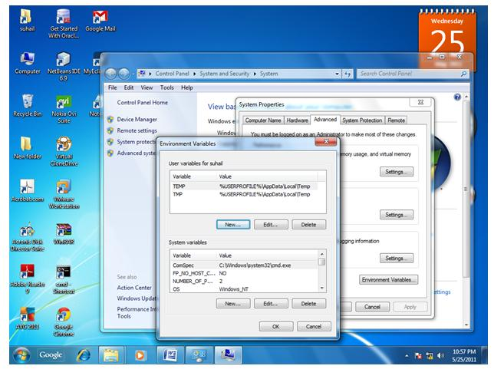
PPT On Java
Path Set in Java:-
Permanent:-
4.Click on new tab of user variables:

Slide 15
PPT On Java
Path Set in Java:-
Permanent:-
5.Write the path variable name:

Slide 16
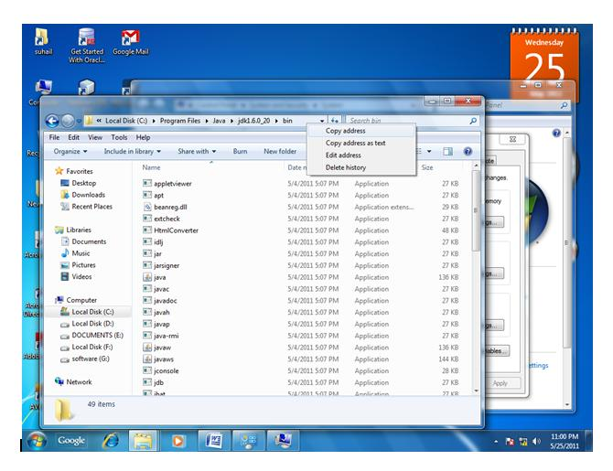
PPT On Java
Path Set in Java:-
Permanent:-
6. Copy the path of the bin folder.

Slide 17
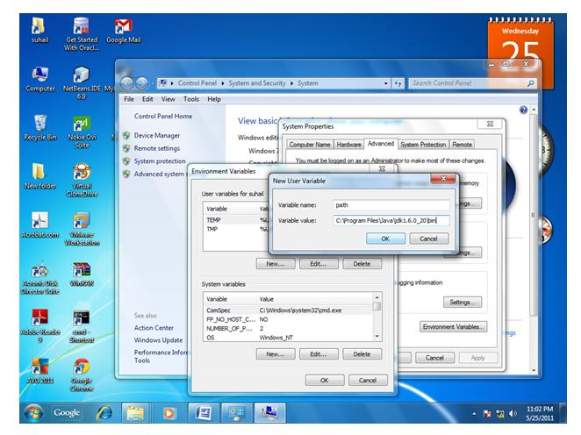
PPT On Java
Path Set in Java:-
Permanent:-
7. paste path of bin folder in variable value

Slide 18
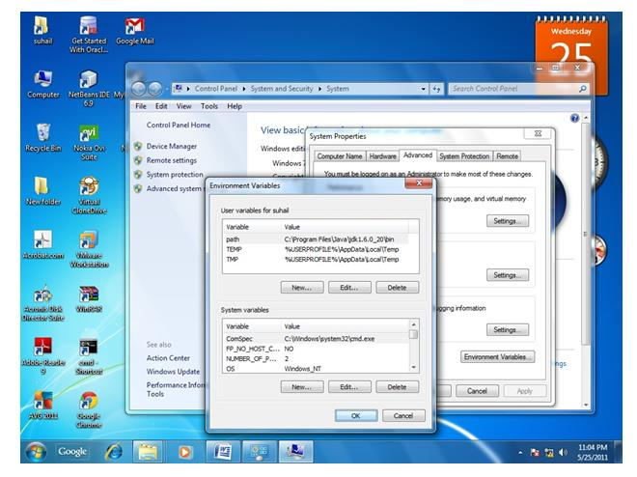
PPT On Java
Path Set in Java:-
Permanent:-
8. click on ok button

Slide 19
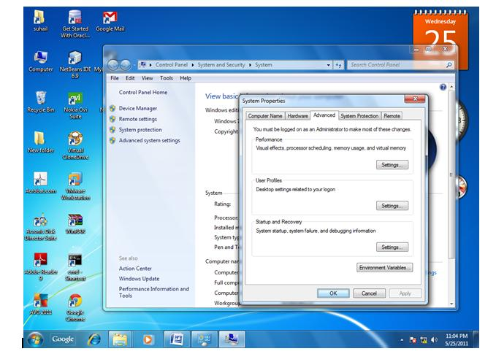
PPT On Java
Path Set in Java:-
Permanent:-
9. click on ok button

Slide 20
PPT On Java
Path Set In Linux:-
export PATH=$PATH:/home/jdk1.6.01/bin/
Here, we have installed the JDK in the home directory under Root (/home).

Slide 21
PPT On Java
JVM :-
JVM (Java Virtual Machine) is an abstract machine. It is a specification that provides runtime environment in which java byte code can be executed.
It is:
A specification where working of Java Virtual Machine is specified. But implementation provider is independent to choose the algorithm. Its implementation has been provided by Sun and other companies.
An implementation Its implementation is known as JRE (Java Runtime Environment).
Runtime Instance Whenever you write java command on the command prompt to run the java class, and instance of JVM is created.

Slide 22
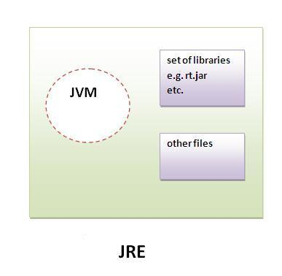
PPT On Java
JRE :-
JRE is an acronym for Java Runtime Environment. It is used to provide runtime environment.It is the implementation of JVM. It physically exists. It contains set of libraries + other files that JVM uses at runtime.

Slide 23
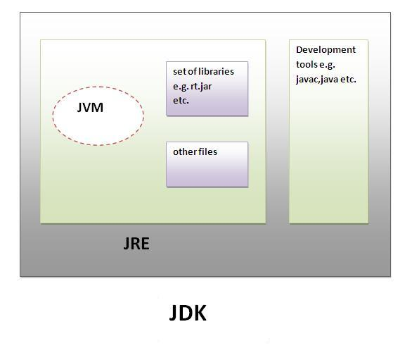
PPT On Java
JDK :-
JDK is an acronym for Java Development Kit. It physically exists. It contains JRE + development tools.

Slide 24
PPT On Java
Variable and Data Types in Java:-
There are three types of variables: local, instance and static. There are two types of data types in java, primitive and non-primitive.
Variable:-
Local Variable
StaticVariable
Instance Variable

Slide 25
PPT On Java
Variable and Data Types in Java:-
A variable is a container which holds the value while the java program is executed. A variable is assigned with a datatype.
Variable is a name of memory location. There are three types of variables in java: local, instance and static.
There are two types of data types in java: primitive and non-primitive.

Slide 26
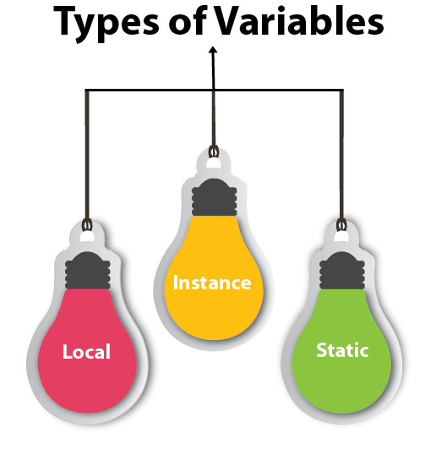
PPT On Java
Variable and Data Types in Java:-
Types of Variable in Java:- There are three types of variables in java:
local variable
instance variable
static variable

Slide 27
PPT On Java
Object and Class in Java:-
Object
Any entity that has state and behaviour is known as an object. For example: chair, pen, table, keyboard, bike etc. It can be physical and logical.
Class
Collection of objects is called class. It is a logical entity.

Slide 28
PPT On Java
Advantage of OOPs over Procedure-oriented programming language:-
1) OOPs makes development and maintenance easier where as in Procedure-oriented programming language it is not easy to manage if code grows as project size grows.
2) OOPs provides data hiding whereas in Procedure-oriented programming language a global data can be accessed from anywhere.
3) OOPs provides ability to simulate real-world event much more effectively. We can provide the solution of real word problem if we are using the Object-Oriented Programming language.

Slide 29
PPT On Java
Difference between Object oriented programming and Procedure Oriented Programming:-
Object based programming language follows all the features of OOPs except Inheritance. JavaScript and VBScript are examples of object based programming languages.

Slide 30
PPT On Java
Method Overloading:-
If a class have multiple methods by same name but different parameters, it is known as Method Overloading.
Advantage of method overloading:-
Method overloading increases the readability of the program.
Different ways to overload the method:-
There are two ways to overload the method in java
By changing number of arguments
By changing the data type

Slide 31
PPT On Java
Different ways to overload the method:-
By changing number of arguments:-
class Calculation{
void sum(int a,int b){System.out.println(a+b);}
void sum(int a,int b,int c){System.out.println(a+b+c);}
public static void main(String args[]){
Calculation obj=new Calculation();
obj.sum(10,10,10);
obj.sum(20,20);
}
}
O/p:-
30
40

Slide 32
PPT On Java
Different ways to overload the method:-
By changing data type:-
class Calculation2{
void sum(int a,int b){System.out.println(a+b);}
void sum(double a,double b){System.out.println(a+b);}
public static void main(String args[]){
Calculation2 obj=new Calculation2();
obj.sum(10.5,10.5);
obj.sum(20,20);
}
}
O/p:-
21.0
40

Slide 33
PPT On Java
Constructor in Java :-
Constructor in java is a special type of method that is used to initialize the object.
Rules for Java Constructor:-
There are basically two rules defined for the constructor.
Constructor name must be same as its class name
Constructor must have no explicit return type
Types of Java Constructor:
Default constructor (no-arg constructor)
Parameterized constructor

Slide 34
PPT On Java
Default Constructor in Java :-
A constructor that have no parameter is known as default constructor.
E.g:-
class Bike1{
Bike1(){System.out.println("Bike is created");}
public static void main(String args[]){
Bike1 b=new Bike1();
}
}
O/p:- Bike is created

Slide 35
PPT On Java
Parameterized Constructor in Java :-
A constructor that have parameters is known as parameterized constructor.
Why use parameterized constructor?
Parameterized constructor is used to provide different values to the distinct objects.

Slide 36
PPT On Java
Example of Parameterized Constructor:-
class Student4{
int id;
String name;
Student4(int i,String n){
id = i;
name = n;
}
void display(){System.out.println(id+" "+name);}
public static void main(String args[]){
Student4 s1 = new Student4(111,"Karan");
Student4 s2 = new Student4(222,"Aryan");
s1.display();
s2.display();
}
}
O/p:-
111 Karan
222 Aryan

Slide 37
PPT On Java
Constructor Overloading :-
Constructor overloading is a technique in Java in which a class can have any number of constructors that differ in parameter lists.The compiler differentiates these constructors by taking into account the number of parameters in the list and their type. class Student5{
int id;
String name;
int age;
Student5(int i,String n){
id = i;
name = n;
}
Student5(int i,String n,int a){
id = i;
name = n;
age=a; }
void display(){System.out.println(id+" "+name+" "+age);}
public static void main(String args[]){
Student5 s1 = new Student5(111,"Karan");
Student5 s2 = new Student5(222,"Aryan",25);
s1.display();
s2.display();
} }
o/p:- 111 Karan 0
222 Aryan 25

Slide 38
PPT On Java
Static Keyword in Java:-
The static keyword in java is used for memory management mainly. We can apply java static keyword with variables, methods, blocks and nested class. The static keyword belongs to the class than instance of the class.
The static can be:
variable (also known as class variable)
method (also known as class method)
block
nested class

Slide 39
PPT On Java
Example of Static Keyword :-
class Student8{
int rollno;
String name;
static String college ="ITS";
Student8(int r,String n){
rollno = r;
name = n;
}
void display (){System.out.println(rollno+" "+name+" "+college);}
public static void main(String args[]){
Student8 s1 = new Student8(111,"Karan");
Student8 s2 = new Student8(222,"Aryan");
s1.display();
s2.display();
}
}
O/p:-
111 Karan ITS
222 Aryan ITS

Slide 40
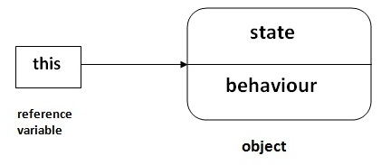
PPT On Java
This Keyword in Java:-
There can be a lot of usage of java this keyword. In java, this is reference variable that refers to the current object.
Use of This keyword:-
this keyword can be used to refer current class instance variable.
this() can be used to invoke current class constructor.
this keyword can be used to invoke current class method (implicitly)
this can be passed as an argument in the method call.
this can be passed as argument in the constructor call.
this keyword can also be used to return the current class instance.

Slide 41
PPT On Java
Understanding a problem without this keyword:-
class Student10{
int id;
String name;
Student10(int id,String name){
id = id;
name = name;
}
void display(){System.out.println(id+" "+name);}
public static void main(String args[]){
Student10 s1 = new Student10(111,"Karan");
Student10 s2 = new Student10(321,"Aryan");
s1.display();
s2.display();
}
}
O/p:- 0 null
0 null

Slide 42
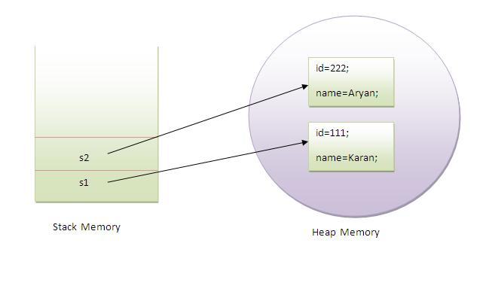
PPT On Java
Problem Solved by this keyword:-
class Student10{
int id;
String name;
Student10(int id,String name){
this.id = id;
this.name = name;
}
void display(){System.out.println(id+" "+name);}
public static void main(String args[]){
Student10 s1 = new Student10(111,"Karan");
Student10 s2 = new Student10(321,"Aryan");
s1.display();
s2.display();
}
}
O/p:- 11 Karan
222 Aryan

Slide 43
PPT On Java
This can be used as a current class constructor :-
The this() constructor call can be used to invoke the current class constructor (constructor chaining). This approach is better if you have many constructors in the class and want to reuse that constructor.
class Student13{
int id;
String name;
Student13(){System.out.println("default constructor is invoked");}
Student13(int id,String name){
this ();//it is used to invoked current class constructor.
this.id = id;
this.name = name;
}
void display(){System.out.println(id+" "+name);}
public static void main(String args[]){
Student13 e1 = new Student13(111,"karan");
Student13 e2 = new Student13(222,"Aryan");
e1.display();
e2.display();
}
}
O/p:- default constructor is invoked default constructor is invoked
111 Karan
222 Aryan

Slide 44
PPT On Java
Where to use this() constructor call:-
The this() constructor call should be used to reuse the constructor in the constructor. It maintains the chain between the constructors i.e. it is used for constructor chaining. Let's see the example given below that displays the actual use of this keyword.

Slide 45
PPT On Java
Inheritance in Java:-
Inheritance in java is a mechanism in which one object acquires all the properties and behaviours of parent object.
The idea behind inheritance in java is that you can create new classes that are built upon existing classes. When you inherit from an existing class, you can reuse methods and fields of parent class, and you can add new methods and fields also.
Where to use Inheritance:-
For Method Overriding (so runtime polymorphism can be achieved).
For Code Reusability.

Slide 46
PPT On Java
Types of Inheritance in Java:-
There are three types of inheritance in java,
Single
Multilevel
Hierarchical

Slide 47
PPT On Java
Why multiple inheritance not supported in Java:-
To reduce the complexity and simplify the language, multiple inheritance is not supported in java.
Consider a scenario where A, B and C are three classes. The C class inherits A and B classes. If A and B classes have same method and you call it from child class object, there will be ambiguity to call method of A or B class.
class A{
void msg(){System.out.println("Hello");}
}
class B{
void msg(){System.out.println("Welcome");}
}
class C extends A,B{//suppose if it were
Public Static void main(String args[]){
C obj=new C();
obj.msg();//Now which msg() method would be invoked?
}
}
O/p:- Compile Time Error

Slide 48
PPT On Java
Aggregation in Java:-
If a class have an entity reference, it is known as Aggregation. Aggregation represents HAS-A relationship.
E.g:-
class Employee{
int id;
String name;
Address address;//Address is a class
...
}
Why we use aggregation?
For Code Reusability.

Slide 49
PPT On Java
Example of Aggregation in Java:-
class Operation{
int square(int n){
return n*n;
}
}
class Circle{
Operation op;//aggregation
double pi=3.14;
double area(int radius){
op=new Operation();
int rsquare=op.square(radius);//code reusability (i.e. delegates the method call).
return pi*rsquare;
}
public static void main(String args[]){
Circle c=new Circle();
double result=c.area(5);
System.out.println(result);
}
}
O/p:-
78.5

Slide 50
PPT On Java
Use of Aggregation in Java:-
Code reuse is also best achieved by aggregation when there is no is-a relationship.
Inheritance should be used only if the relationship is-a is maintained throughout the lifetime of the objects involved; otherwise, aggregation is the best choice.

Slide 51
PPT On Java
Method Overriding in Java:-
If subclass (child class) has the same method as declared in the parent class, it is known as method overriding in java.
Use of Method Overriding:-
Method overriding is used to provide specific implementation of a method that is already provided by its super class.
Method overriding is used for runtime polymorphism
Rules for method Overriding:-
method must have same name as in the parent class
method must have same parameter as in the parent class.
must be IS-A relationship (inheritance).

Slide 52
PPT On Java
Understanding a problem without method overloading:-
class Vehicle{
void run(){System.out.println("Vehicle is running");}
}
class Bike extends Vehicle{
public static void main(String args[]){
Bike obj = new Bike();
obj.run();
}
}
O/p:-
Vehicle is running

Slide 53
PPT On Java
Understanding a problem with method overloading:-
class Vehicle{
void run(){System.out.println("Vehicle is running");}
}
class Bike2 extends Vehicle{
void run(){System.out.println("Bike is running safely");}
public static void main(String args[]){
Bike2 obj = new Bike2();
obj.run();
}
O/p:-
Bike is running safely

Slide 54
PPT On Java
Final Keyword in Java:-
The final keyword in java is used to restrict the user. The java final keyword can be used in many context. Final can be:
variable
method
class

Slide 55
PPT On Java
Polymorphism in Java:-
Polymorphism in java is a concept by which we can perform a single action by different ways. Polymorphism is derived from 2 Greek words: poly and morphs. The word "poly" means many and "morphs" means forms. So polymorphism means many forms.
There are two types of polymorphism in java: compile time polymorphism and runtime polymorphism. We can perform polymorphism in java by method overloading and method overriding.

Slide 56
PPT On Java
Static Binding and Dynamic Binding in Java:-
Static Binding:-
When type of the object is determined at compiled time(by the compiler), it is known as static binding.
If there is any private, final or static method in a class, there is static binding.
Example of static binding:-
class Dog{
private void eat(){System.out.println("dog is eating...");}
public static void main(String args[]){
Dog d1=new Dog();
d1.eat();
}
}

Slide 57
PPT On Java
Static Binding and Dynamic Binding in Java:-
Dynamic Binding:-
When type of the object is determined at run-time, it is known as dynamic binding.
Example of dynamic binding:-
class Animal{
void eat(){System.out.println("animal is eating...");}
}
class Dog extends Animal{
void eat(){System.out.println("dog is eating...");}
public static void main(String args[]){
Animal a=new Dog();
a.eat();
}
}
O/p:- dog is eating...

Slide 58
PPT On Java
Abstract Class in Java:-
A class that is declared as abstract is known as abstract class. It needs to be extended and its method implemented. It cannot be instantiated.
Example of Abstract Class:-
abstract class A{}

Slide 59
PPT On Java
Example of Abstract Class that has Abstract Method:-
abstract class Bike{
abstract void run();
}
class Honda4 extends Bike{
void run(){System.out.println("running safely..");}
public static void main(String args[]){
Bike obj = new Honda4();
obj.run();
}
}
O/p:-
running safely..

Slide 60
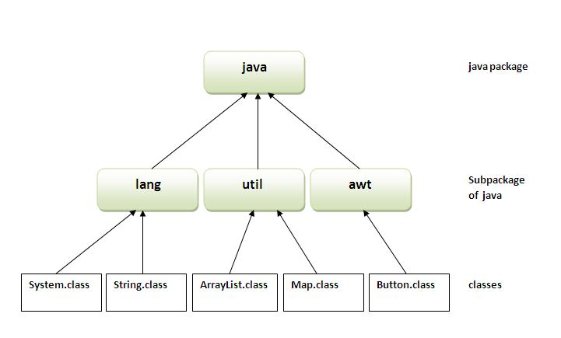
PPT On Java
Packages in Java:-
A java package is a group of similar types of classes, interfaces and sub-packages.
Package in java can be categorized in two form, built-in package and user-defined package.
Advantages of Package:-
1) Java package is used to categorize the classes and interfaces so that they can be easily maintained.
2) Java package provides access protection.
3) Java package removes naming collision.

Slide 61
PPT On Java
How to run the package program:-
You need to use fully qualified name e.g. mypack.Simple etc to run the class.
To Compile:
javac -d . Simple.java
To Run:
java mypack.Simple
Output:Welcome to package
The -d is a switch that tells the compiler where to put the class file i.e. it represents destination. The . represents the current folder.

Slide 62
PPT On Java
How to access package from another package:-
There are three ways to access the package from outside the package.
import package.*;
import package.classname;
Fully qualified name.

Slide 63
PPT On Java
Access modifier in Java:-
There are 4 types of java access modifiers:
private
default
protected
Public

Slide 64
PPT On Java
Encapsulation in java:-
Encapsulation in java is a process of wrapping code and data together into a single unit, for example capsule i.e. mixed of several medicines.
Advantage of Encapsulation in java:-
By providing only setter or getter method, you can make the class read-only or write-only.
It provides you the control over the data. Suppose you want to set the value of id i.e. greater than 100 only, you can write the logic inside the setter method.

Slide 65
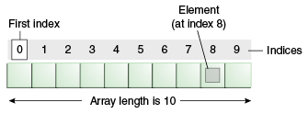
PPT On Java
Java Array:-
Normally, array is a collection of similar type of elements that have contiguous memory location.
Java array is an object the contains elements of similar data type. It is a data structure where we store similar elements. We can store only fixed set of elements in a java array.

Slide 66
PPT On Java
Advantages and Disadvantages of Java Array:-
Advantage:-
Code Optimization: It makes the code optimized, we can retrieve or sort the data easily.
Random access: We can get any data located at any index position.
Disadvantage:-
Size Limit

Slide 67
PPT On Java
Types of Java Array:-
Single Dimensional Array
Multi Dimensional Array

Slide 68
PPT On Java
Wrapper Class in Java:-
Wrapper class in java provides the mechanism to convert primitive into object and object into primitive.
Since J2SE 5.0, autoboxing and unboxing feature converts primitive into object and object into primitive automatically. The automatic conversion of primitive into object is known and autoboxing and vice-versa unboxing.

Slide 69
Thank You

